Slide 1

The Future of Tropical Rain Forests (IDS 2935)
9-1: Paradox of Luxuriance
Emilio M. Bruna
Fall 2021

Slide 2
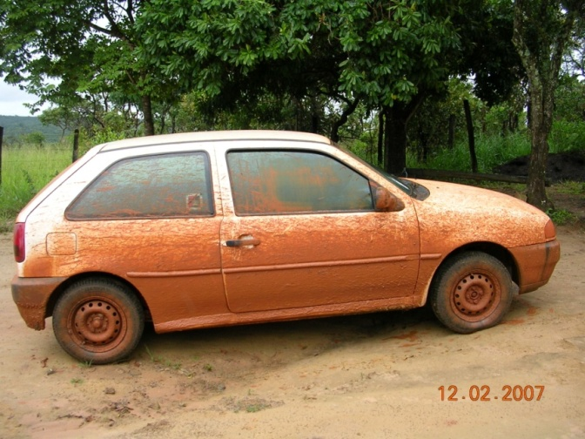
It all comes down to
SOIL

Slide 3
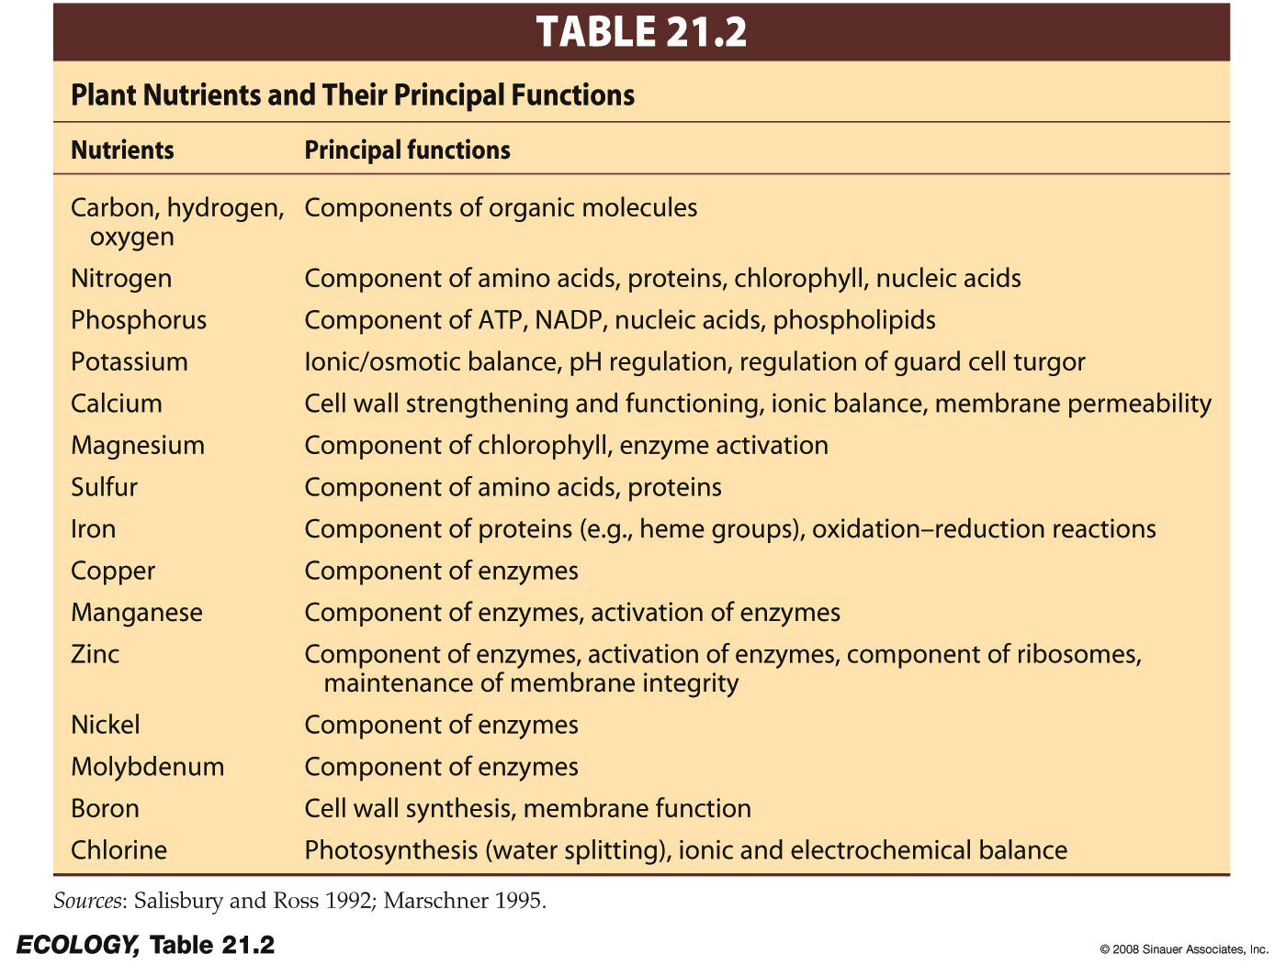
Soil Chemistry
Macronutrients: Needed in large amounts.
Micronutrients: Needed in trace amounts

Slide 4


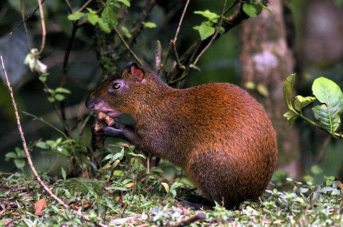
organisms at higher trophic levels get (most of) them from their food
Plants get nutrients from their environment

Slide 5
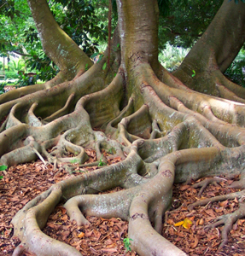
Nutrients must be present in simple, water soluble forms for plant roots to take them up
Ca²⁺
K⁺
Mg²⁺
Many of these are positively charged ions…this will be important later!
Question: what determines the supply of nutrients in these forms that make them available for uptake by plants?

Slide 6
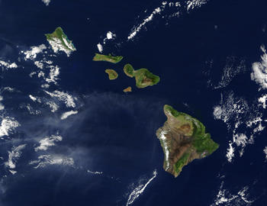
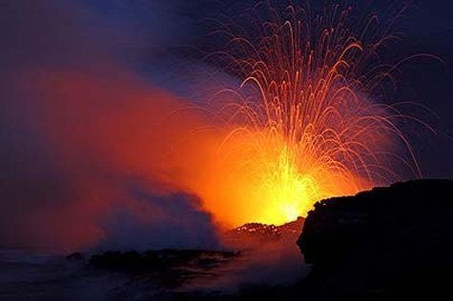
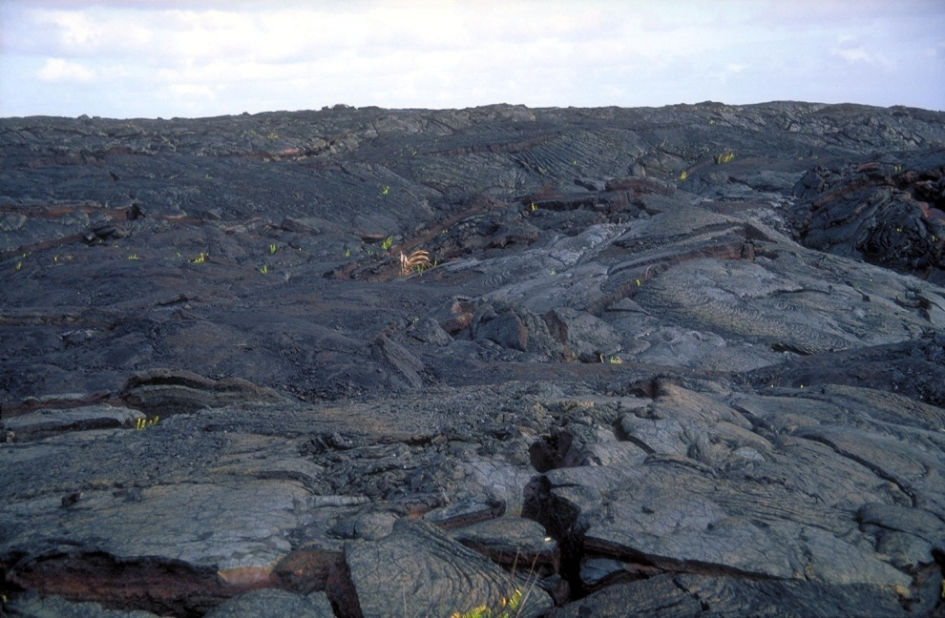
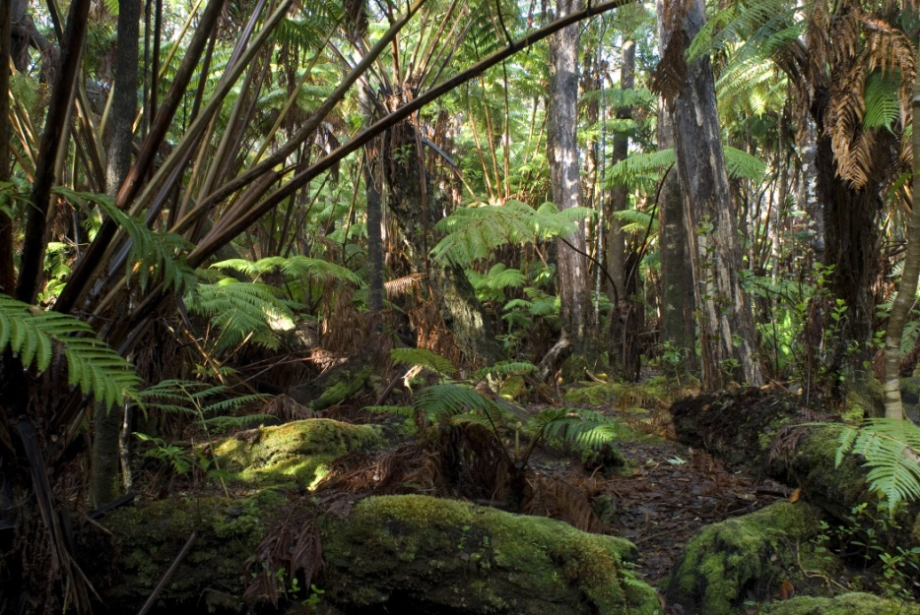
Answer: Nutrients first enter ecosystems (primarily) through the physical and chemical breakdown of minerals in rocks.

Slide 7
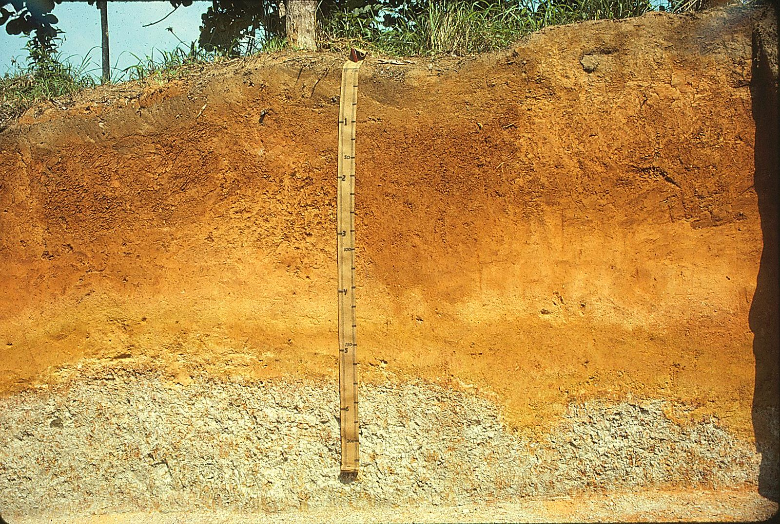
Soil
Layer of chemically and biologically altered material that overlies rock
Photo: Soil Science Typic Hapludult (fine-loamy, mixed, semiactive, isohyperthermic) In Loreto, Peru. (CC BY 2.0)
Notes:
Some people add the definition of supporting life for plants…mention recent argument over sediments and aquatic soils.

Slide 8
Three key properties of soil:
TEXTURE
WATER RETENTION CAPACITY
CHEMISTRY
1) Texture: size distribution of mineral particles
Sand
Silt
Clay
2 - 0.5 mm
0.002 - 0.5 mm
<0.002 mm

Slide 9
1) Texture: size distribution of mineral particles
Sand
Silt
Clay
2 - 0.5 mm
0.002 - 0.5 mm
<0.002 mm
Largest Ratio of SA:V
Weak negative charge attracts positively charged Ions*
Absorb water

Slide 10
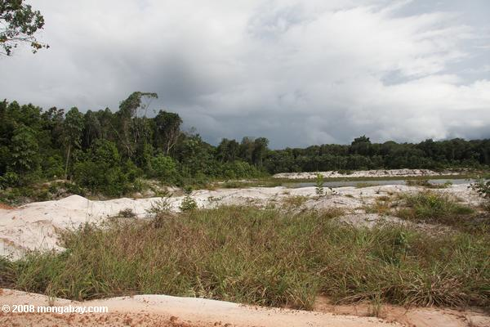
Determined by type of particles in soil & their distribution throughout the soil
2) Water Retention Capacity
Clay Soils:
Hold large volumes of water
Sandy Soils:
Drain Well
What does this mean for nutrient availability?

Slide 11
3) Soil Chemistry: soil pH strongly influences nutrient availability
pH: large concentration of H⁺ (acidic)
pH: low concentration of H⁺ (Basic or alkaline)
Clay
-
H⁺
K⁺
A little acidity promotes nutrient availability. How?
Below about pH 5.5…nutrients leach out of the soil. Maximum soil fertility: pH = 6.0-7.2

Slide 12
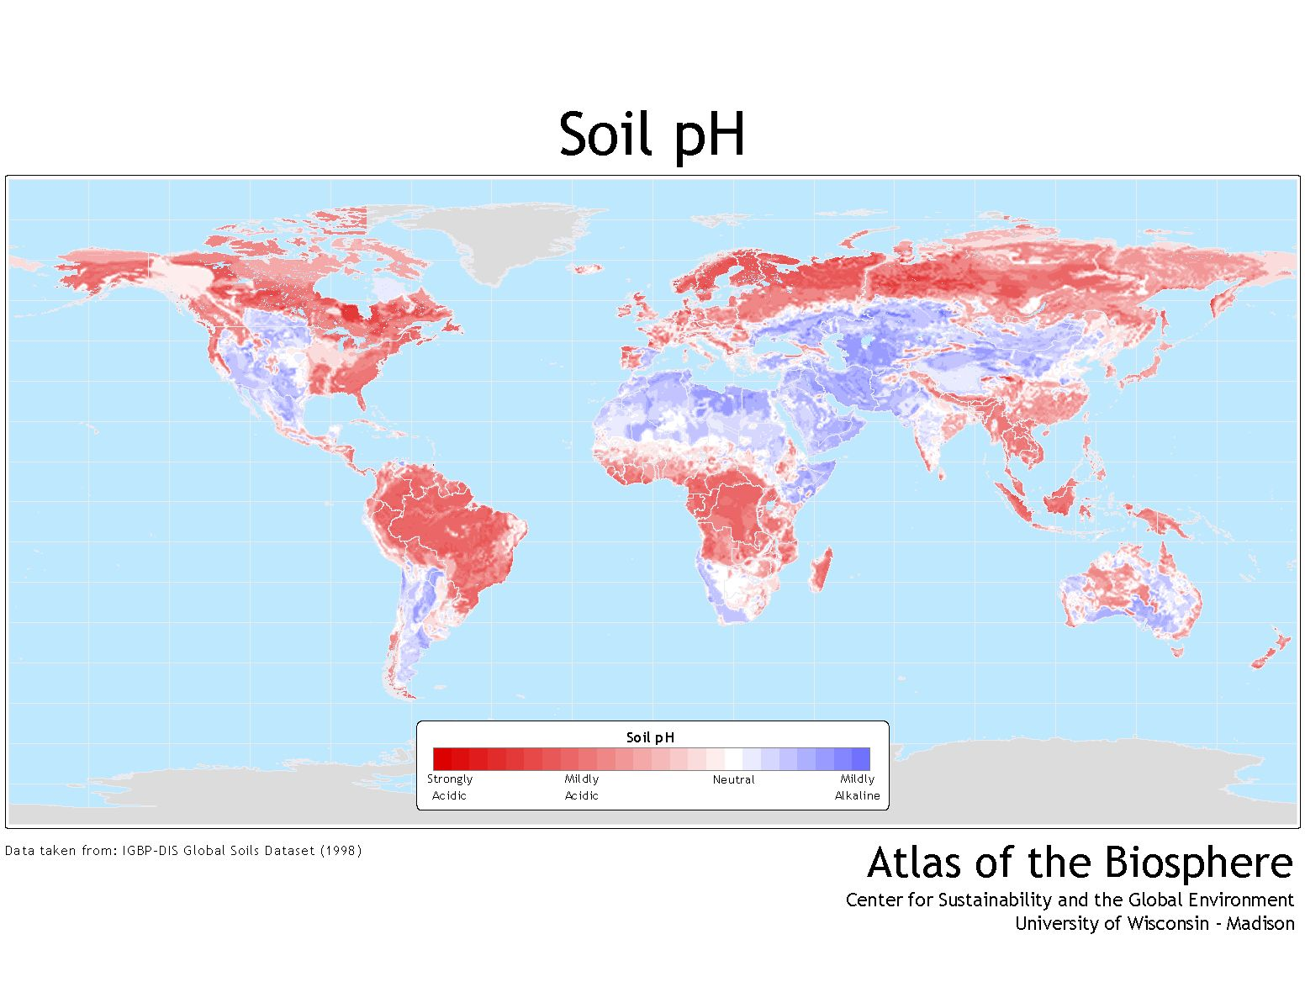
“Typical” tropical soil pH = 4.2-5.0

Slide 13
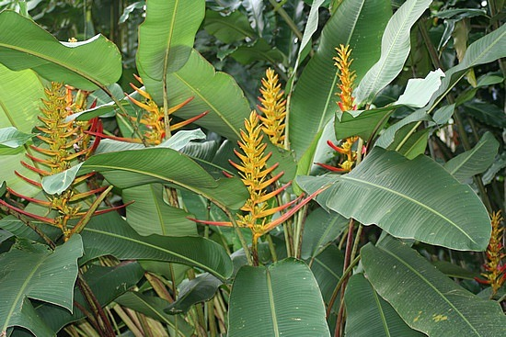
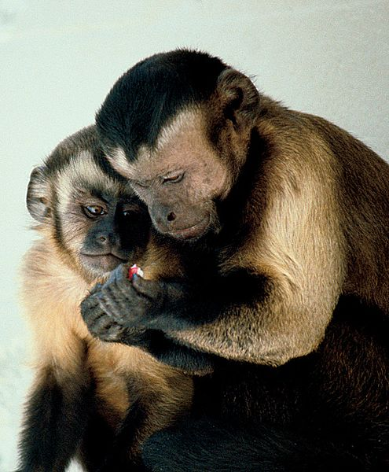
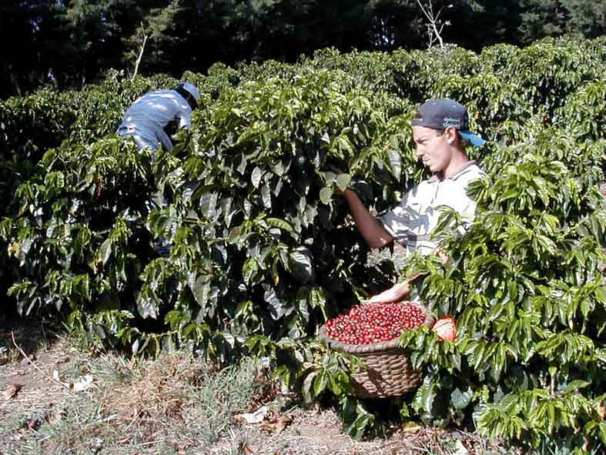
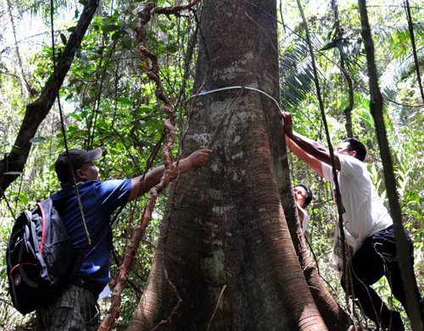
Variability in soil quality has major ecological impacts
Plant fertility
Animal abundance,
Home range sizes,
Human settlement and agriculture
Forest biomass

Slide 14
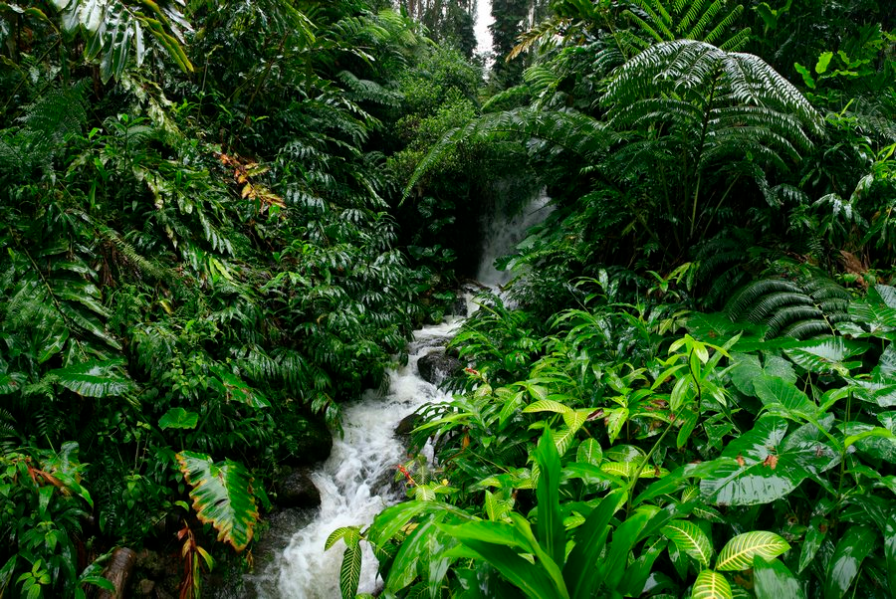
So if tropical soils are so terrible, where did all this productivity come from?
© copyright by Johnathan Esper

Slide 15
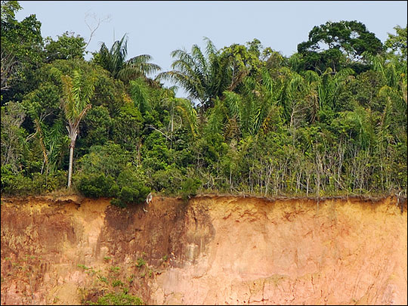
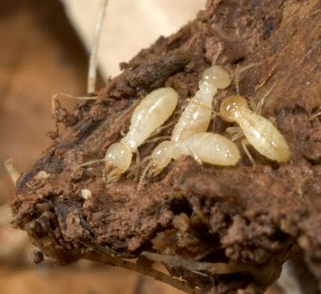
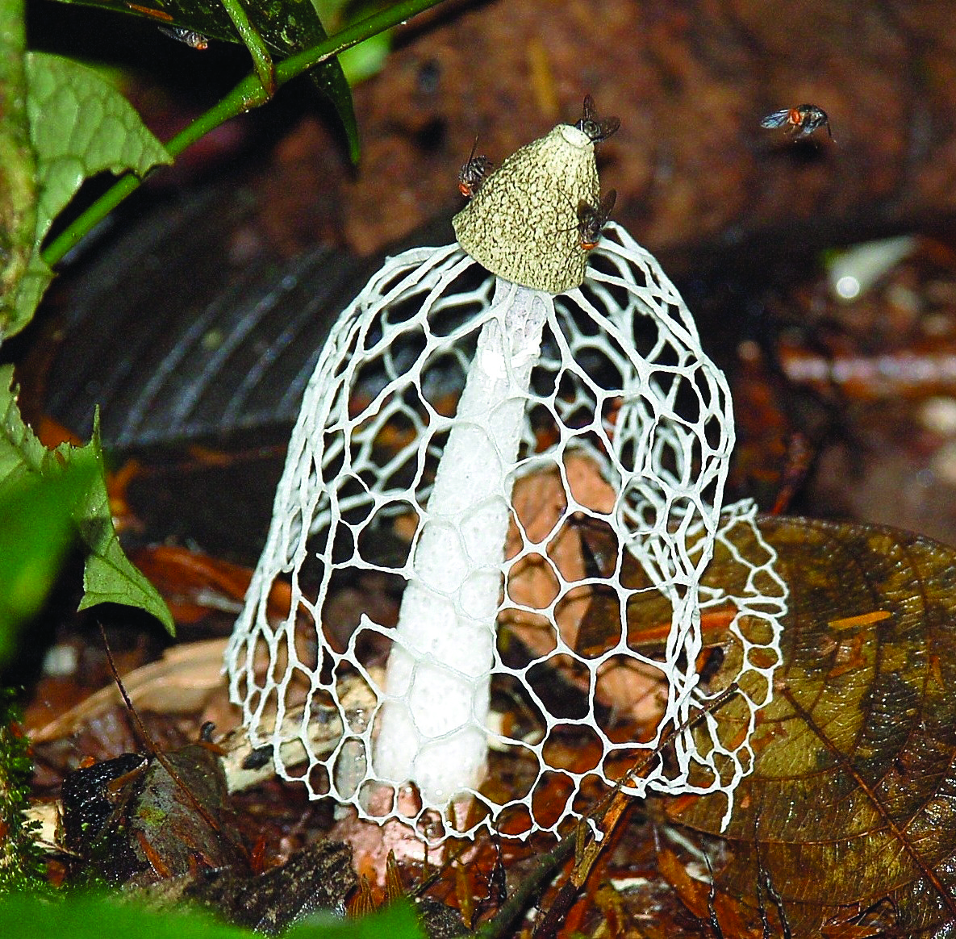
Most of the nutrients in Trop. Rain Forests are in the living (tree) biomass.

Slide 16
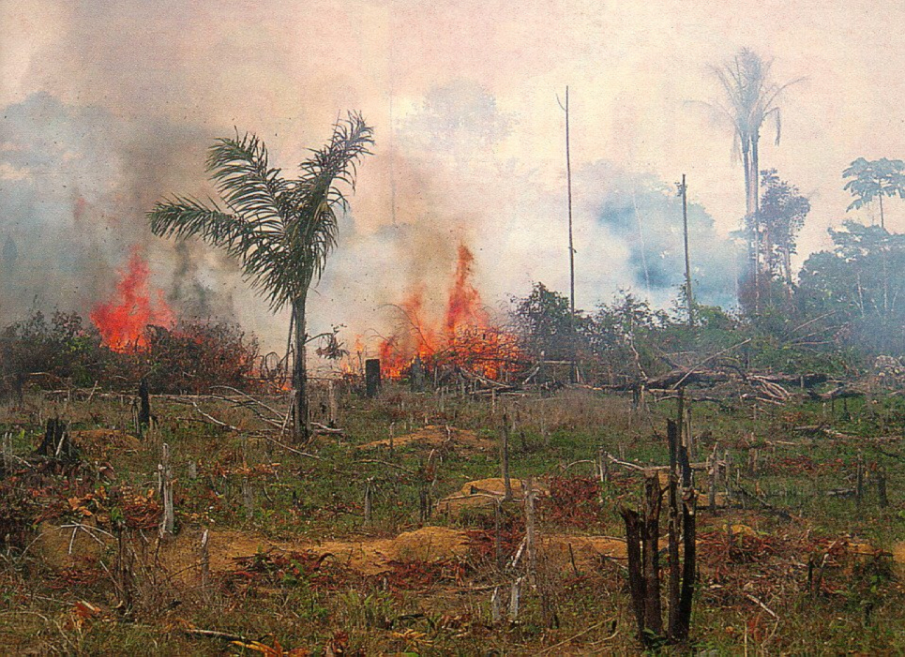
When tropical forests are cleared and burned, most nutrients are lost in smoke and ash and soil erosion.
If severe enough, these ecosystems can take centuries to return to their previous state.

Slide 17
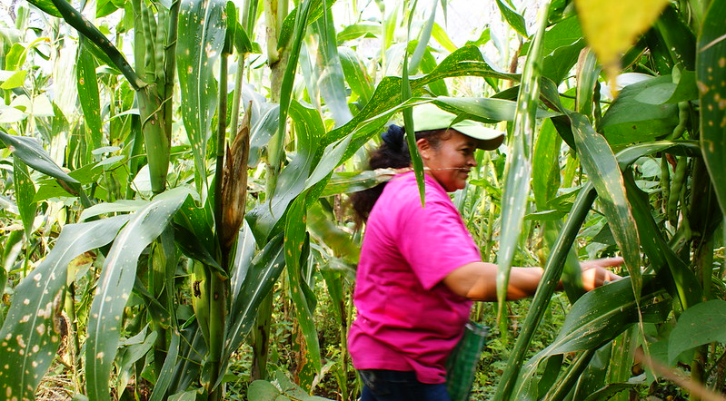
Photo by Feria de Productores: Maíz / Milpa
Tangamandapio, Michoacán (CC BY 2.0)

Slide 18
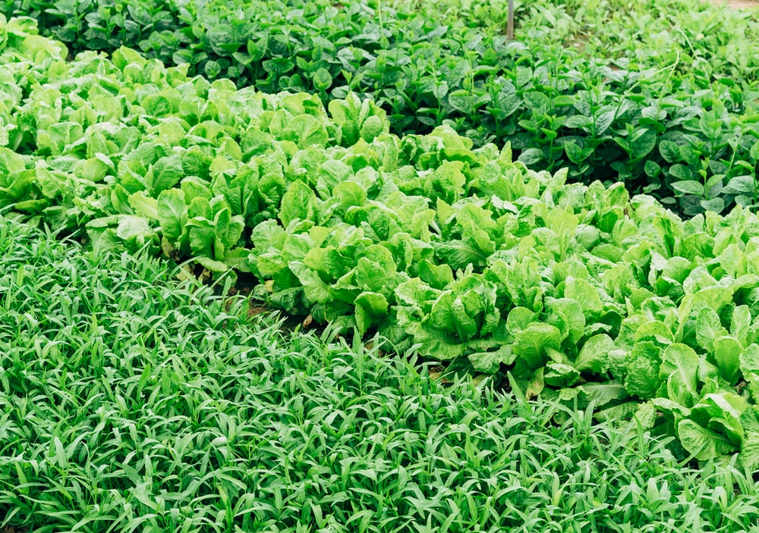
John Terborgh called this
“The Paradox of Luxuriance”

Slide 19
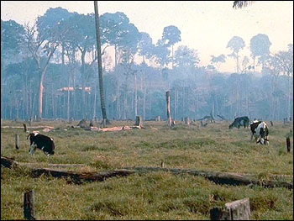
John Terborgh called this
“The Paradox of Luxuriance”

Slide 20
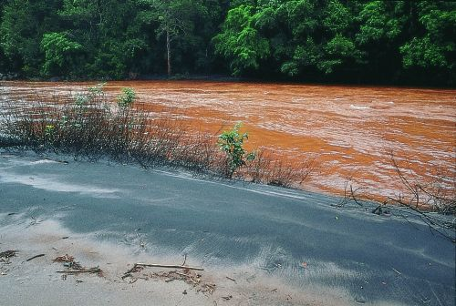
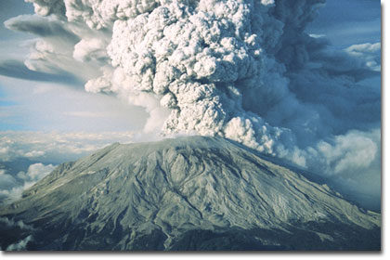
How do nutrients get back into the soils?
Rain
Exposure of new parent material
River deposits
Volcanoes
Outer space
Nutrient Cycling / Decomposition

Slide 21
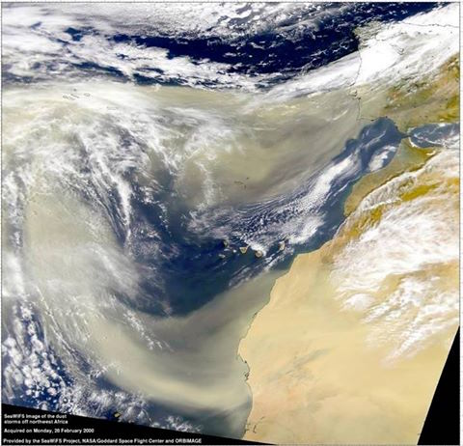

Slide 22

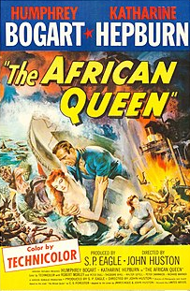
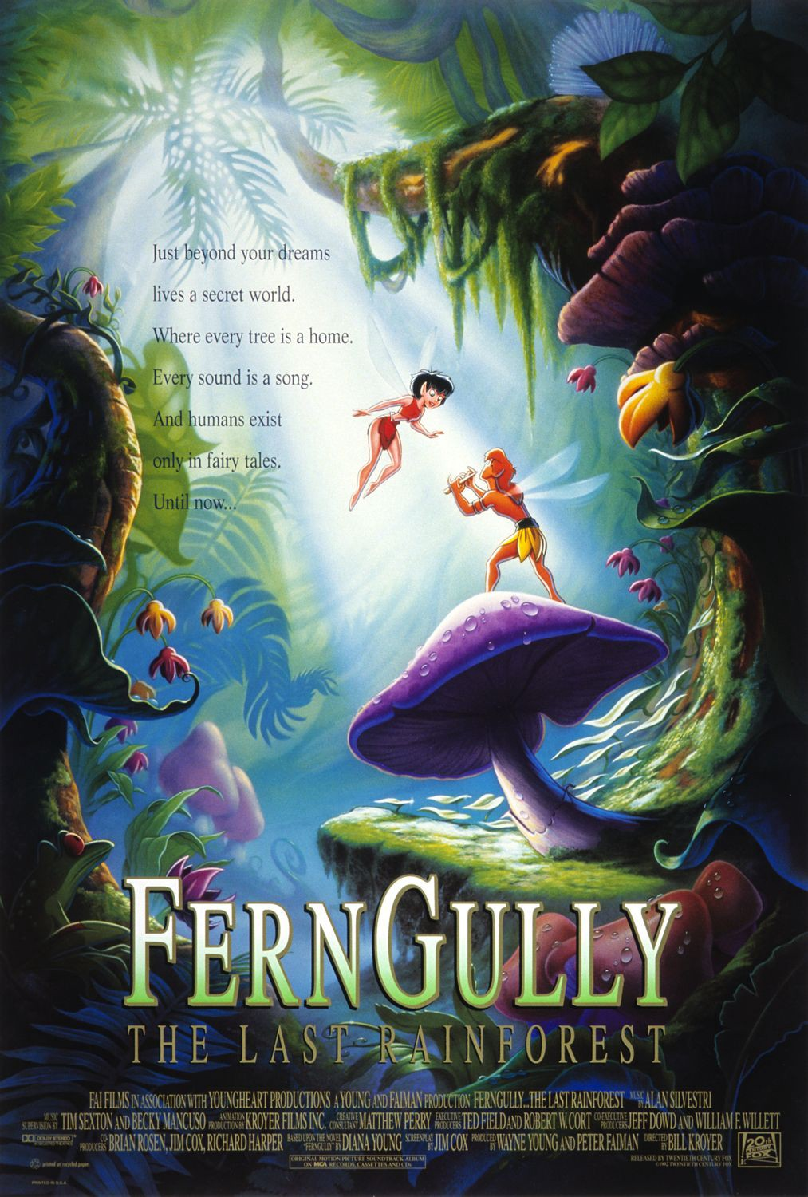
Aguirre, The Wrath of God (1972)
The African Queen (1951)
FernGully, the Last Rainforest (1992)
Directed, Written, & Produced by Werner Herzog
Inspired by account of Amazonian expedition by Gaspar de Carvajal
Filmed in Peru (Huayna Pichu, Urubamba Valley)
“Kosmiche” soundtrack by Popol Vuh
Heavily influenced FFC’s Apocalypse Now
Rotten Tomatoes: 96%
Directed & co-Written by John Huston
German East Africa = Parts of today’s Burundi, Rwanda, Tanzania
Filmed on location in Uganda
Selected for preservation in National Film Registry
HB’s only Academy Award
Rotten Tomatoes: 98%
Ton Loc as Goanna Lou
Rotten Tomatoes: 63%
Notes:
FernuGully: Grossed US$32,710,894 worldwide
Where are the First Nations (what used to be called “Aboriginal)
Christian Slater = Pips
Tim Curry Hexus
“ecological Balance”
“Balance between forces of destruction and the magic forces of creation”
Humans are our best friends (?)
Not a lot of Australian accents
Pteropodidae is the family for fruit bats
He came out of a lab, humans abvude animals in a lab
Sanctimonious
In the book Disney, Pixar, and the Hidden Messages of Children's Films, M. Keith Booker stated the film was "somewhat vague in its explanation of the dire consequences of rainforest destruction and it addresses the economic impetus behind this destruction hardly at all"; the fact that the rainforest was saved at the end of the film "diminishes the urgency of its environmentalist message" and that the character of Hexxus "displaces the real blame for environmental destruction from its real perpetrators onto nonexistent supernatural perpetrators, further diluting the political message."
Producer Wayne Young said his passion for the environment was his motivation for making the film, saying the film was "blatantly environmental, although we have gone to a lot of trouble to avoid preaching. We also want it to be viewed as entertainment.”
The film was shown at the United Nations General Assembly on Earth Day, April 22, 1992. ^{(GOOD LORD)}
African Queen
for being "culturally, historically or aesthetically significant”

Slide 23
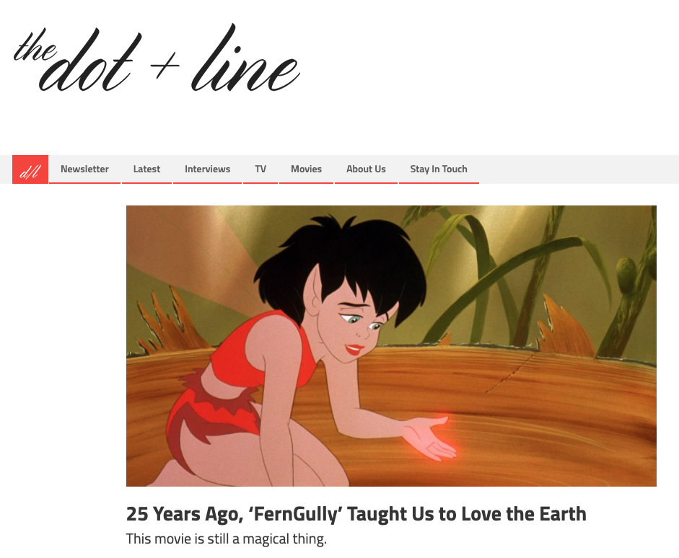
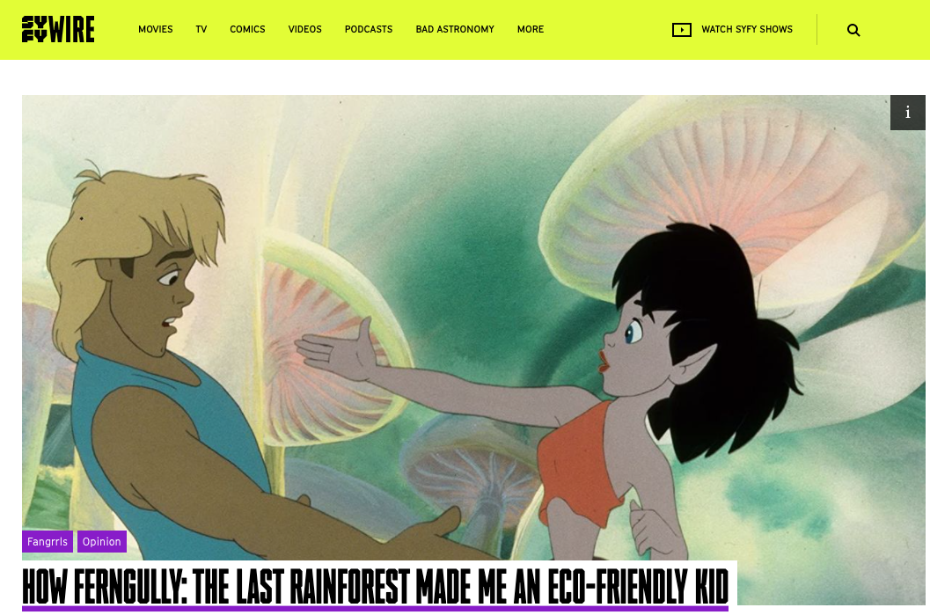

Slide 24


